Slide 1

Android Dev Tips I
Catch run-time exceptions, send crash reports and still remain user friendly
Stefan Anca
02.07.2012

Slide 2
Agenda
Problem Analysis
Solutions
Error Reporting
Implementation
Conclusions

Slide 3
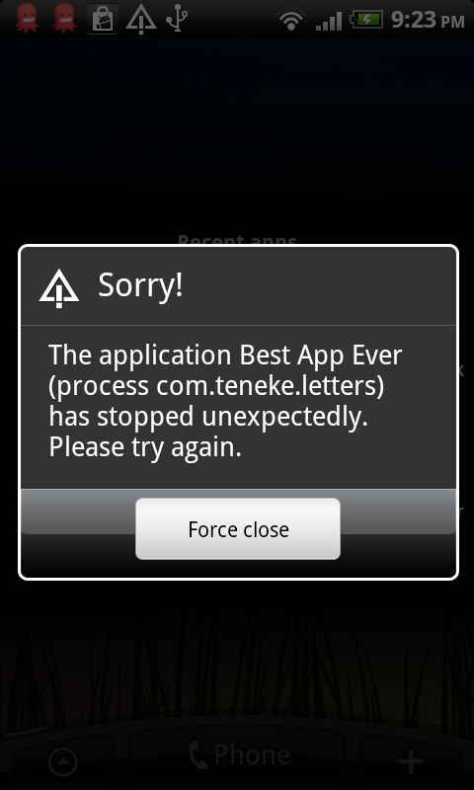
Problem: Runtime Crash

Slide 4
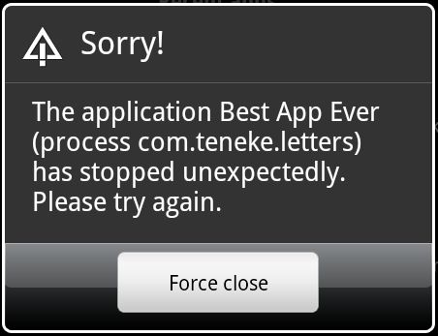
Reasons
Inflexible programming: internet unreachable, camera not available, sensor missing, etc.
SDK level incompatible (project target, android:minSdkVersion)
Configuration Change unhandled
Android problems
Hardware problems
…

Slide 5
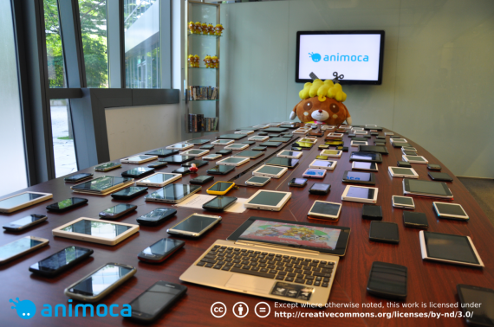
Solutions
Program better!
Test it yourself!

Slide 6
Solutions (II)
Pay others to test it for you before launch
AppDemoStore
TESTDROID Cloud
Vodafone online test & verification (Perfecto Mobile)
Built-in Error Reporting
Google Error Reporting
Do-it-yourself Error Reporting

Slide 7
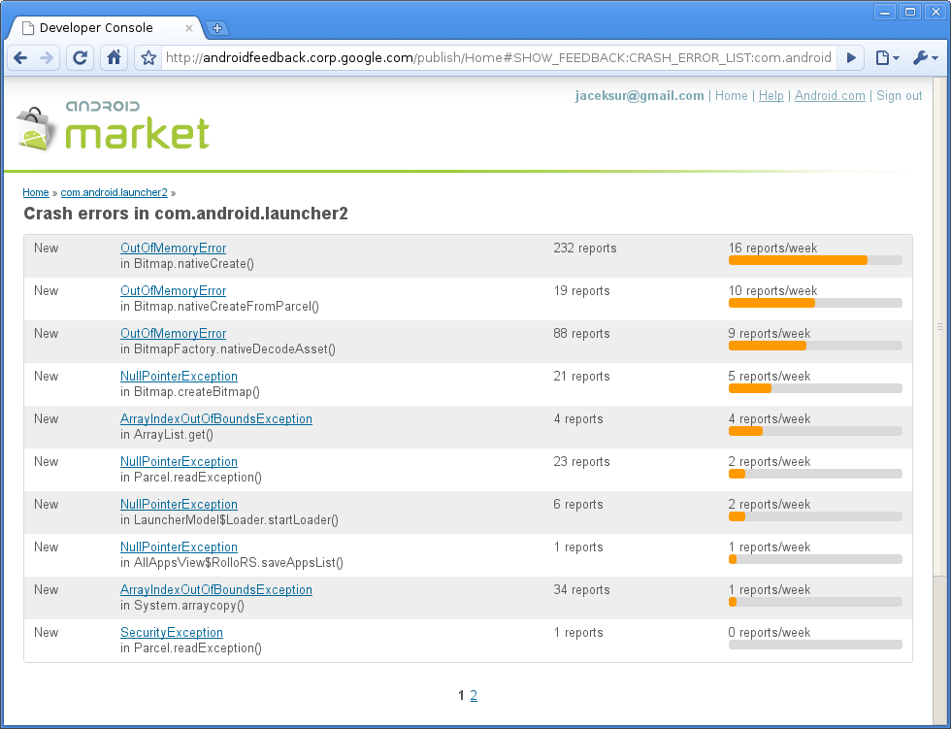
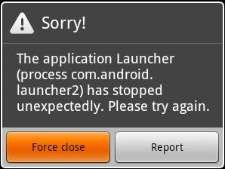
Google Error Reporting
Application Error Reporting in Google Play
Available since SDK 8 (Froyo)
Reports available in the market account
Somewhat Unreliable
Users don’t report!

Slide 8
DIY Error Reporting
ACRA (free lib)
Android Error Reporter (free lib)
android-remote-stacktrace (free lib)
android-log-collector (free apk)
Apphance (online service - freemium)
BugSense (online service - freemium)
Hockey App (online service - $10/month)
Crittercism (online service - freemium)
…

Slide 9
DIY Error Reporting (II)
How is it done?
Catch Exception
Show user a nice dialog
Ask the user to send error report (HTTP/Email)
Analyze report (server side)

Slide 10
1. Catch Exception
UncaughtExceptionHandler
import java.lang.Thread.UncaughtExceptionHandler;
public class CustomExceptionHandler implements UncaughtExceptionHandler{
@Override
public void uncaughtException(Thread t, Throwable e) { }
}
public class FlipCardApplication extends Application {
@Override
public void onCreate() {
super.onCreate();
Thread.setDefaultUncaughtExceptionHandler(new
CustomExceptionHandler(this));
}}

Slide 11
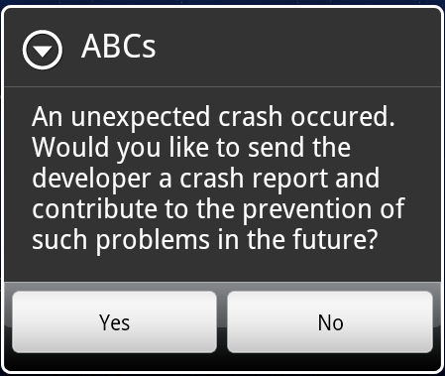
2-3. Show user a nice dialog; Ask user to send error report

Slide 12
2-3. Show user a nice dialog; Ask user to send error report(II)
AlertDialog.Builder alert = new AlertDialog.Builder(this);
alert.setMessage("An unexpected crash occured. Would you like to send " + "the developer a crash report and contribute to the prevention of " + "such problems in the future?");
alert.setTitle(appName);
alert.setPositiveButton("Yes", new DialogInterface.OnClickListener() {
public void onClick(DialogInterface dialog, int whichButton) {
// Send report, then die
}
});
alert.setNegativeButton("No", new DialogInterface.OnClickListener() {
public void onClick(DialogInterface dialog, int whichButton) {
// Die
}
});
alert.show();

Slide 13
Technical Details
The activity where the crash takes place must die!
The application must die! Otherwise, unstable state.
defaultUEH = Thread.getDefaultUncaughtExceptionHandler();
defaultUEH.uncaughtException(t, e); //Raises Standard Error Dialog
OR
Process.killProcess(Process.myPid()); //Dirty but no dialog
System.exit(10); //Make sure to clean activity/app state before this
Error reporting must take place in a different activity!
Error reporting must take place in a different process!
<application android:name="com.package.ABCApplication">
<activity android:name="com.package.MainActivity" />
<activity android:name="com.package.CrashReportActivity"
android:taskAffinity="com.package.TASK.CrashReportActivity"
android:process="com.package.CrashReportProcess" />

Slide 14
Uncaught Exception Handler (II)
@Override
public void uncaughtException(Thread t, Throwable e) {
String report = Log.getStackTraceString(e) + '\n';
// If the exception was thrown in a background thread inside
// AsyncTask, then the actual exception can be found with getCause
Throwable cause = e.getCause();
if (cause != null)
report += Log.getStackTraceString(cause);
Intent intent = new Intent(ctx, CrashReportActivity.class);
intent.putExtra('report', report);
intent.setFlags(Intent.FLAG_ACTIVITY_NEW_TASK);
ctx.startActivity(intent);
currentActivity.finish(); //IMPORTANT: Clean up app state!
Process.killProcess(Process.myPid()); //Dirty
System.exit(10);
}

Slide 15
Crash Report Activity
public class CrashReportActivity extends Activity {
@Override
protected void onCreate(Bundle savedInstance) {
super.onCreate(savedInstance);
Bundle extras = getIntent().getExtras();
if (extras != null) {
this.report = extras.getString('report');
}
}

Slide 16
Crash Report Activity (II)
@Override
protected void onStart() {
super.onStart();
AlertDialog.Builder alert = new AlertDialog.Builder(this);
alert.setMessage("An unexpected crash occurred...");
alert.setPositiveButton("Yes", new DialogInterface.OnClickListener() {
public void onClick(DialogInterface dialog, int whichButton) {
Intent i = new Intent(Intent.ACTION_SEND);
i.putExtra(Intent.EXTRA_EMAIL, 'debug@domain.com');
i.putExtra(Intent.EXTRA_SUBJECT, 'Crash Report');
i.putExtra(Intent.EXTRA_TEXT, this.report);
i.setType("message/rfc822");
CrashReportActivity.startActivity(Intent.createChooser(i, "Send crash report"));
Process.killProcess(Process.myPid()); System.exit(10);
}
});
alert.setNegativeButton("No", ...);
alert.show();
}

Slide 17
4. Analyze reports
Send Crash Reports to Server
HTTP POST
Email
Server
PHP Script + MySQL Database
Google Spreadsheet (ACRA)
Inbox

Slide 18
Extra Error Reporting
Users don’t report when asked to!
Short reporting through Google Analytics
tracker.trackPageView("ABCs/85/google/Error/" + errorLine);
Implementation – Uncaught Exception Handler:
Pattern pattern = Pattern.compile("^\\s*at (com.fivepumpkins.*)", Pattern.MULTILINE);
Matcher matcher;
matcher = pattern.matcher(report); // report is the stack trace string
if (matcher.find()) {
String errorLine = matcher.group(1);
tracker.trackPageView("ABCs/" + appVersion + "/" + publisher + "/Error" + errorLine);
}

Slide 19
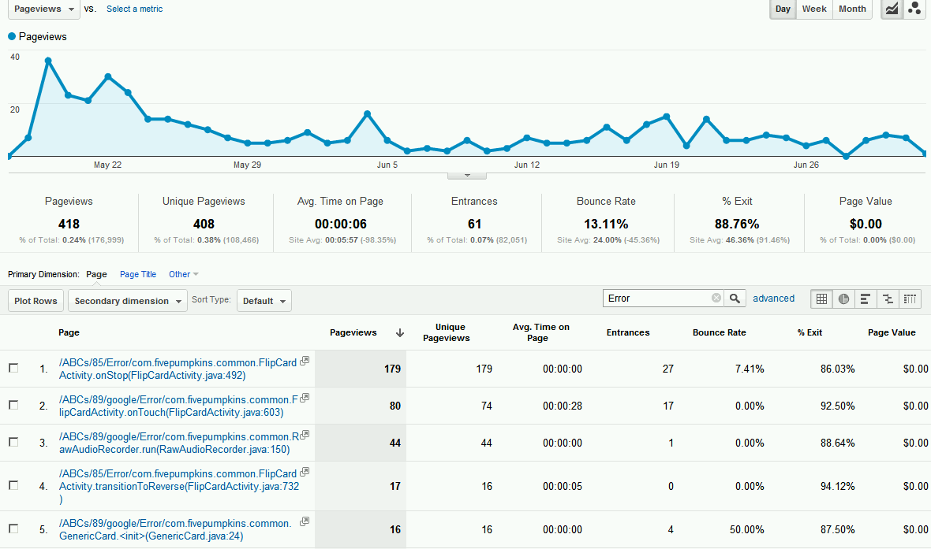
Google Analytics Reports

Slide 20
4. Analyze reports (II)
Application: ABCs (by Fivepumpkins)
Interval: 17.05.2012 – 02.07.2012 (~6 weeks)
Visits: 83,471
Unique Visitors: 24,304
418 Errors
8 Crash Reports!!!
5 Emails reporting bugs

Slide 21
Conclusions
Users hate bugs but hate reporting them even more!
User-driven Error-Reporting is the tip of the iceberg
Automatic Crash Reports are the safest bet
Users are the best QA
Reply to active users!

Slide 22
References
http://stackoverflow.com/
http://developer.android.com/reference
http://www.google.com/analytics/
http://web.fivepumpkins.com/
http://www.animoca.com

Slide 23
Thank you
Questions?

